Slide 1
Message passing and Erlang
10/31/2016

Slide 2
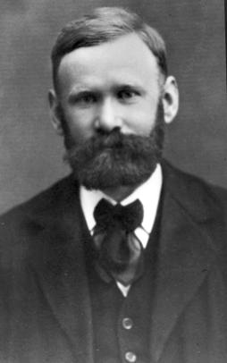
History of Erlang
Erlang either refers to Danish mathematician and engineer Agner Krarup Erlang, or alternatively, as an abbrev. of "Ericsson Language“.
Experiments with Erlang started in Ellemtel Computer Science Laboratory in 1987.
First version was developed by Joe Armstrong.
Agner Krarup Erlang (1878-1929)
Inventor of the fields: traffic engineering and queueing theory (foundation of telecom network studies).

Slide 3
Cool features of Erlang
Started out as a concurrent Prolog.
High reliability. (e.g. Ericsson Switch)
“You need mechanisms and primitives provided to the general programmer or the developer in order for the systems to have these properties, otherwise they tend to get lost in the way.“ – Lennart Ohman, Developer of Open Telecom Platform (OTP), MD of Sjoland & Thyselius Telecom AB in Sweden.
Seamless scaling to large number of processes (literally 100,000 processes) through message passing communication.
Functional programming (Seq.) + OO (Conc.).
Concurrency for the sake of modularity, reliability etc.
Library support (web-server, databases etc.)

Slide 4
Properties
Functional
Dynamic typing
Concurrency-oriented programming
Asynchronous message passing
Lightweight processes (100’s of thousands!)
Not quite like threads…
Anonymous functions
List comprehensions, map, fold, …
Tuples, lists, binaries, …
…

Slide 5


Projects using Erlang
Ericsson AXD301 switch (1998).
reported to achieve a reliability of nine “9”s (i.e. 1 sec of downtime in 1 billion seconds, roughly 30 years.)
CouchDB, a document based database that uses MapReduce.
ejabberd, instant messaging server
Facebook chat system based on ejabberd.
Twitterfall, a service to view trends and patterns from Twitter
whatsApp, a messaging service
…

Slide 6


The Future of Erlang
Scalability: "Virtually all language use shared state concurrency. This is very difficult and leads to terrible problems when you handle failure and scale up the system...Some pretty fast-moving startups in the financial world have latched onto Erlang; for example, the Swedish www.kreditor.se.“ – Joe Armstrong, “Programming Erlang”.
Promise for multi-core apps: "I do not believe that other languages can catch up with Erlang anytime soon. It will be easy for them to add language features to be like Erlang. It will take a long time for them to build such a high-quality VM and the mature libraries for concurrency and reliability. So, Erlang is poised for success. If you want to build a multicore application in the next few years, you should look at Erlang.“ – Ralph Johnson (UIUC), “Erlang, the next Java”.
Joe Armstrong, author of Erlang
Ralph Johnson, co-author of the now-legendary book, "Design Patterns"

Slide 7
Erlang functions
-module(recurs).
-export([fac/1]).
fac(0) -> 1;
fac(N) -> N * fac(N-1).

Slide 8
Erlang: pattern matching
Pattern-matching selects components of the data
‘_’ is a “don’t care” pattern (not a variable)
‘[]’ is the empty list
‘[X,Y,Z]’ is a list with exactly three elements
‘[X,Y,Z|Tail]’ has three or more elements

Slide 9
Erlang functions
-module(mylists).
-export([reverse/1]).
reverse(L) -> reverse(L, []).
reverse([H|T], L) -> reverse(T, [H|L]);
reverse([], L) -> L.

Slide 10
Symbols and tuples
-module(tut3).
-export([convert_length/1]).
convert_length( {centimeter, X} ) -> {inch, X / 2.54};
convert_length( {inch, Y} ) -> {centimeter, Y * 2.54}.

Slide 11
Guards
-module(tut6).
-export([list_max/1]).
list_max([Head|Rest]) -> list_max(Rest, Head).
list_max([], Res) -> Res;
list_max([Head|Rest], Result_so_far)
when Head > Result_so_far ->
list_max(Rest, Head);
list_max([Head|Rest], Result_so_far) ->
list_max(Rest, Result_so_far).

Slide 12
Notes
Can only assign to variables once (with “=“)
Subsequently, “=“ means “check if equal to”
Variables start with capital letters
Symbols start with lower-case symbols

Slide 13
Quicksort
-module(qsort).
-export([qsort/1]).
qsort([]) -> [];
qsort([Pivot|Rest]) ->
qsort([Front || Front <- Rest, Front < Pivot]) ++
[Pivot] ++
qsort([Back || Back <- Rest, Back >= Pivot]).
++ concatenates two lists; -- removes items from a list

Slide 14
List comprehensions
> [2*N || N <- [1,2,3,4]].
[2,4,6,8]
> [X || X <- [1,2,3,4,5,6,7,8,9,10], X rem 2 =:= 0].
[2,4,6,8,10]

Slide 15
Concurrency oriented programming
Processes are totally independent
imagine they run on different machines
Process semantics = No sharing of data = Copy-everything message passing.
Sharing = inefficient (can’t go parallel) + complicated (mutexes, locks, ..)
Each process has an unforgeable name
If you know the name of a process you can send it a message
Message passing is ”send and pray”
you send the message and pray it gets there
You can monitor a remote process

Slide 16
COPL
A language is a COPL if:
Process are truly independent
No penalty for massive parallelism
No unavoidable penalty for distribution
Concurrent behavior of program same on all OSs
Can deal with failure

Slide 17
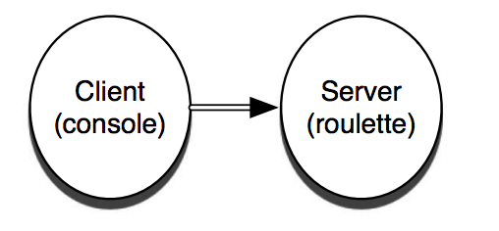
Simple server
-module(translate).
-export([loop/0]).
loop() ->
receive
"casa" ->
io:format("house~n"),
loop();
"blanca" ->
io:format("white~n"),
loop();
_ ->
io:format("I don't understand.~n"),
loop()
end.
Pid = spawn(fun translate:loop/0).

Slide 18
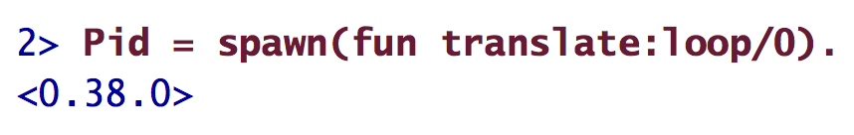
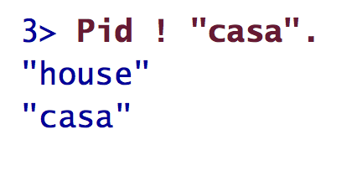
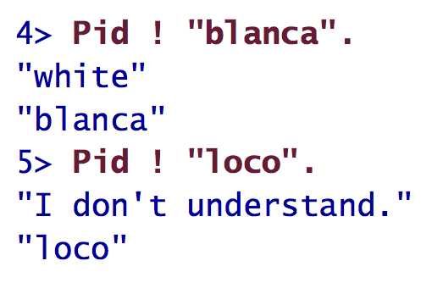

Slide 19
-module(translate_service).
-export([loop/0, translate/2]).
loop() ->
receive
{From, "casa"} ->
From ! "house",
loop();
{From, "blanca"} ->
From ! "white",
loop();
{From, _} ->
From ! "I don't understand.",
loop()
end.
translate(To, Word) ->
To ! {self(), Word},
receive
Translation -> Translation
end.

Slide 20
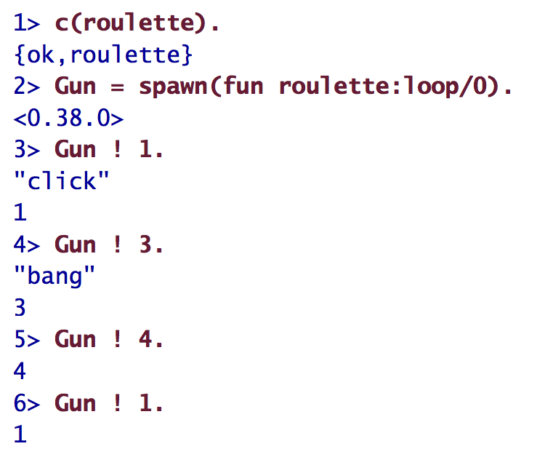
-module(roulette).
-export([loop/0]).
% send a number, 1-6
loop() ->
receive
3 -> io:format("bang.~n"), exit({roulette,die,at,erlang:time()});
_ -> io:format("click~n"), loop()
end.

Slide 21
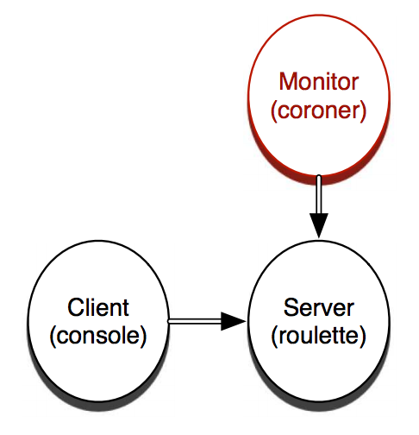
-module(coroner).
-export([loop/0]).
loop() ->
process_flag(trap_exit, true),
receive
{monitor, Process} ->
link(Process),
io:format("Monitoring process.~n"),
loop();
{'EXIT', From, Reason} ->
io:format("The shooter ~p died with reason ~p.", [From, Reason]),
io:format("Start another one.~n"),
loop()
end.
Notes:
Note: receives can also have guards

Slide 22
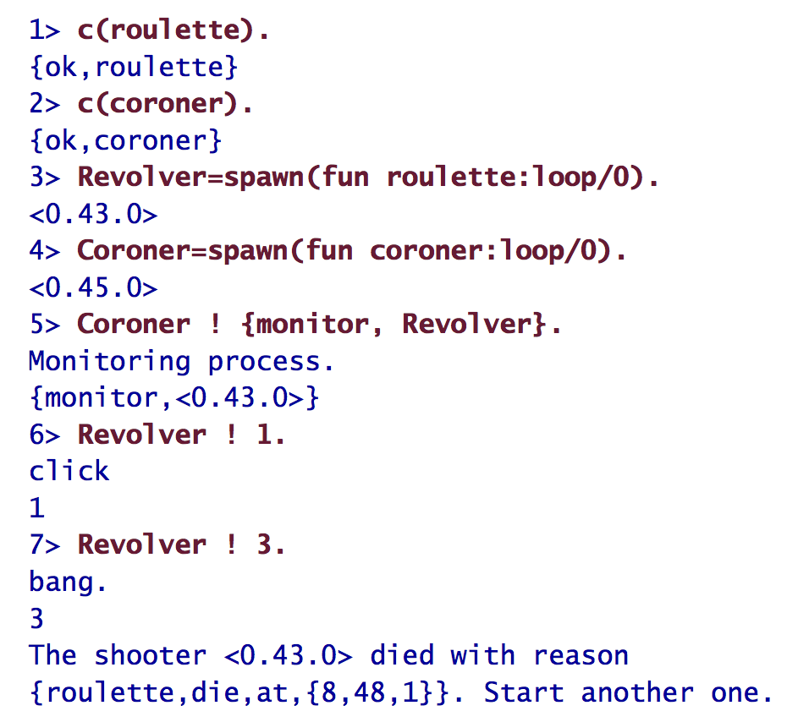

Slide 23
-module(doctor).
-export([loop/0]).
loop() ->
process_flag(trap_exit, true),
receive
new ->
io:format("Creating and monitoring process.~n"),
register(revolver, spawn_link(fun roulette:loop/0)),
loop();
{'EXIT', From, Reason} ->
io:format("The shooter ~p died with reason ~p.", [From, Reason]),
io:format(" Restarting. ~n"),
self() ! new,
loop()
end.

Slide 24
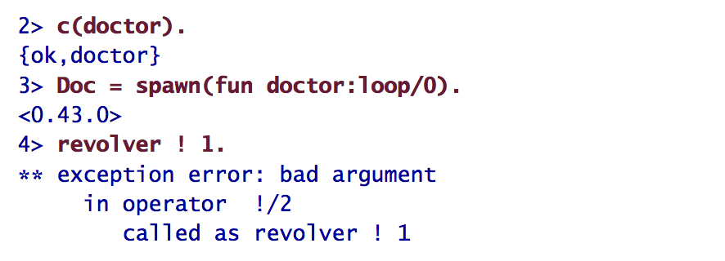
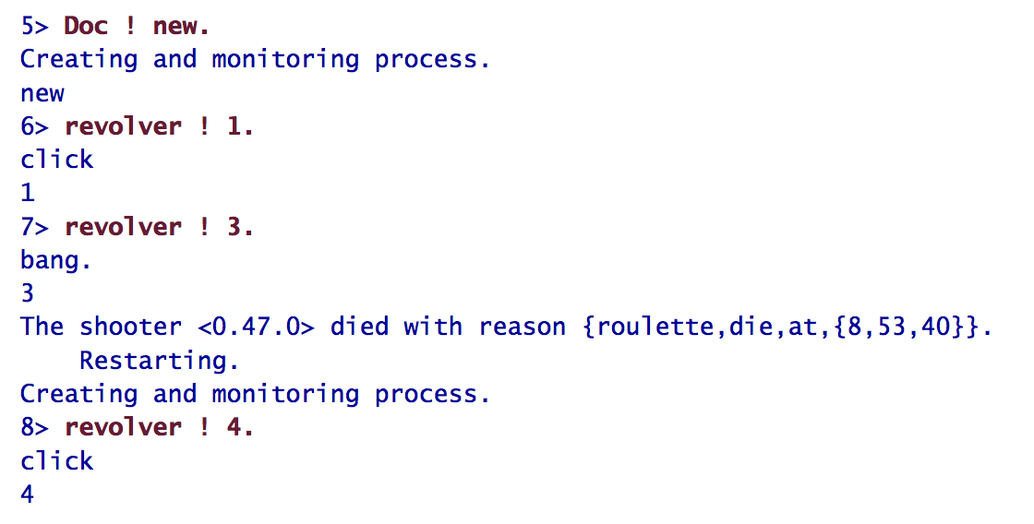

Slide 25
Erlang: “Let it crash!”
“The view is that you don't need to program defensively. If there are any errors, the process is automatically terminated, and this is reported to any processes that were monitoring the crashed process. In fact, defensive programming in Erlang is frowned upon.”
Notes:
http://c2.com/cgi/wiki?LetItCrash

Slide 26
Erlang: “Let it crash!”
“Only program the happy case, what the specification says the task is supposed to do.”
“When writing code from a specification, the specification says what the code is supposed to do, it does not tell you what you’re supposed to do if the real world situation deviates from the specification”
“So what do the programmers do? ... they take ad hoc decisions”
Notes:
https://mazenharake.wordpress.com/2009/09/14/let-it-crash-the-right-way/

Slide 27
Erlang: “Let it crash!”
“If a hardware failure requires any immediate administrative action, the service simply won’t scale cost-effectively and reliably. The entire service must be capable of surviving failure without human administrative interaction. Failure recovery must be a very simple path and that path must be tested frequently.
Armando Fox of Stanford has argued that the best way to test the failure path is never to shut the service down normally. Just hard-fail it. This sounds counter-intuitive, but if the failure paths aren’t frequently used, they won’t work when needed.”

Slide 28
Erlang: “Let it crash!”
Do I know how I’m supposed to handle an error here?
If not, then should I handle it? (Thus going back to specification)
If something goes wrong in this function call, can I continue?
E.g. Line 2 depends on a file descriptor from line 1
When I restart, can I recover from the crash here?
If not then it is a good indication that you need a specification for how to handle the error. Can I reset my state? Do I need to clean up? etc are also good questions to ask yourself
Am I crashing in a valid place?
E.g. you should never crash (intentionally) inside a gen_server unless it is some kind of a worker process. A “main” process shouldn’t really be allowed to crash in the same sense as a worker process can. A worker process, say for an HTTP request, shouldn’t really be very defensive (perhaps a top-level try-catch to return some useful error)
Notes:
https://mazenharake.wordpress.com/2009/09/14/let-it-crash-the-right-way/

